Slide 1
CS 663 Project
Face Swapping
Team Members
Nikhil 170050099
Preetam 170070042

Slide 2
Overview of the Project
Our project is based on work done by Feng Huang and Wu
Task -
Given an image, identify the face, facial features and replace it with a similar face from the database.

Slide 3
Algorithm
Steps -
Face Detection and Facial features extraction
Replacement face selection
Extracting the region of the face to be replaced
Color blending

Slide 4
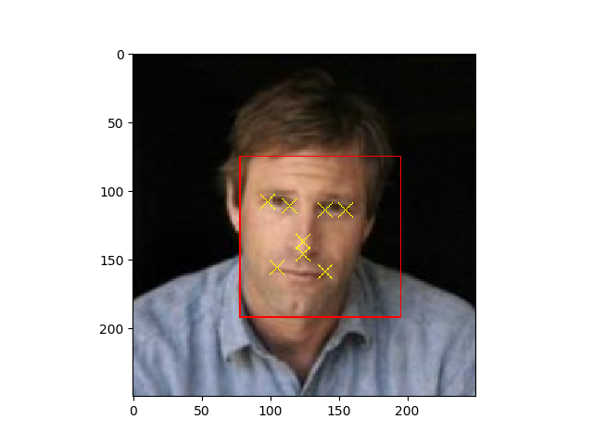
Facial Landmarks Detection

Slide 5
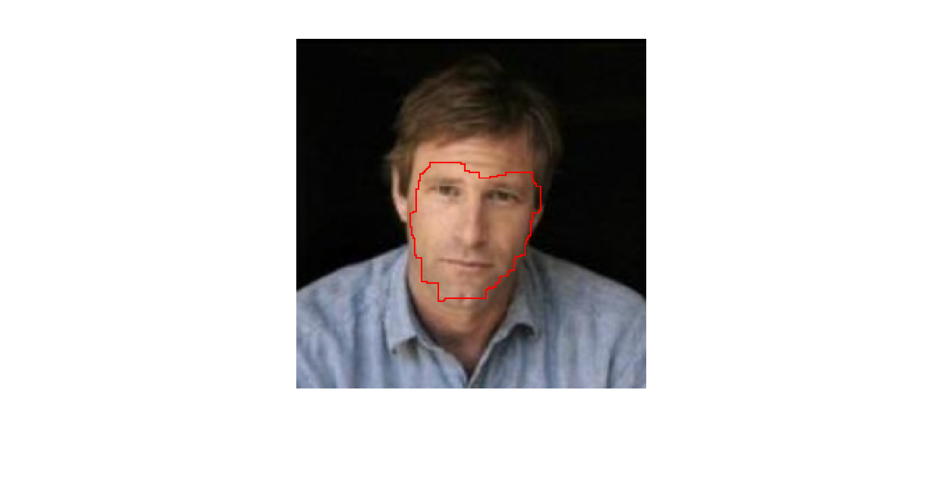
Face extraction

Slide 6
Details of implementation
Facial features detection done on python
Facial extraction done on MATLAB
Dataset - handpicked frontal faces in LFW

Slide 7
Experiments
Deciding on cost function - magnitude of gradient or square of gradients?
How to constrain the search for optimal seam? Explored tradeoffs. Optimality vs Complexity

Slide 8
Thankyou!

